Slide 1
Machine Learning Project: ATP Tennis Analysis

Slide 2
Agenda
Andrew (Clustering)
Patricia (Random Forest)
Harish (End Point Tracking)
Cy & Sirish (ETL process and fun stuff ☺ )
Conclusion

Slide 3
Clustering
Gathered major tournament match statistics from UCI
Designed Alteryx workflow to clean up data and organize match statistics by player
Utilized python tool within Alteryx to determine clusters
Summarized data uploaded to Tableau server

Slide 4
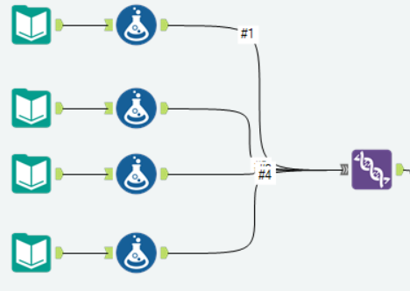
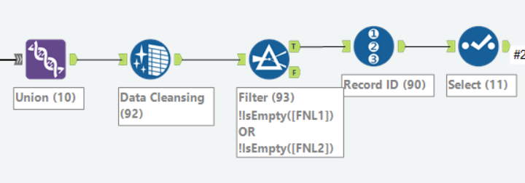
Data Cleanup (Alteryx)
Used formula tool to create new columns containing gender, name of tournament, and court surface (grass, clay, etc.)
Unioned major tournament data
Replaced null values in 'Final Games' columns with blanks, filtered out blank fields (drop n/a)
Assigned match a record ID
Selected essential data fields to
carry forward in workflow
Separated, and rejoined individual player data from matches to condense 'Player 1' and 'Player 2' fields into a single 'Player' field

Slide 5
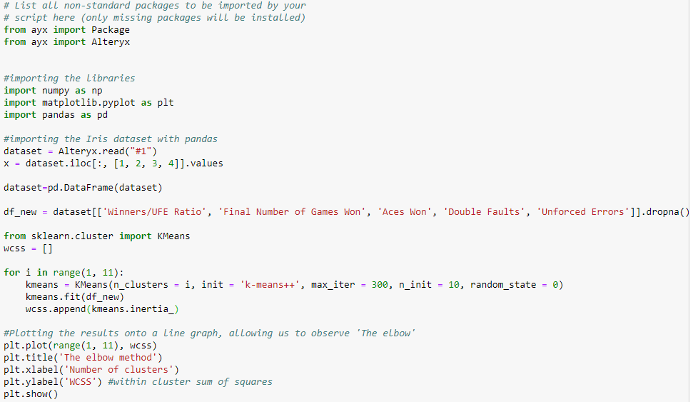
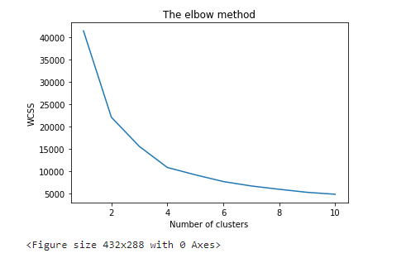
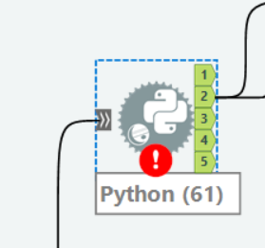
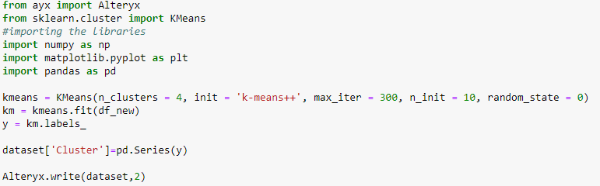
Clustering
Summarized player data plugged in to Python tool
Utilized Elbow method to validify optimal number of clusters
Use K-Means to cluster players

Slide 6
Playstyles
Baseliner:
Counterpuncher:
All Court:
Server & Volleyer:

Slide 7
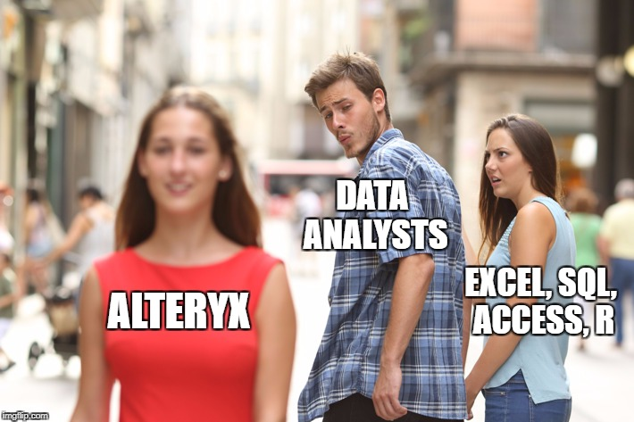

Slide 8
Random Forest
Patricia
To
Add
Steps

Slide 9
Random Forest (Patricia)

Slide 10
Random Forest (Patricia)

Slide 11
Predicting Point End Using Tracking Data
Harish
To
Add
Steps

Slide 12
Predicting Point Ending Using Tracking Data (Harish)

Slide 13
Predicting Point Ending Using Tracking Data (Harish)

Slide 14
ETL Process
Cy & Sirish
To
Add
Steps

Slide 15
ETL Process

Slide 16
ETL Process

Slide 17
Conclusion
Points
Made
Questions?

